Slide 1
SSO In One Enterprise
Why we need SSO and how to implement it

Slide 3
SSO In One Enterprise
Why we need SSO and how to implement it
What is SSO :
SSO Single Sign On (SSO) 单点登录。

Slide 4
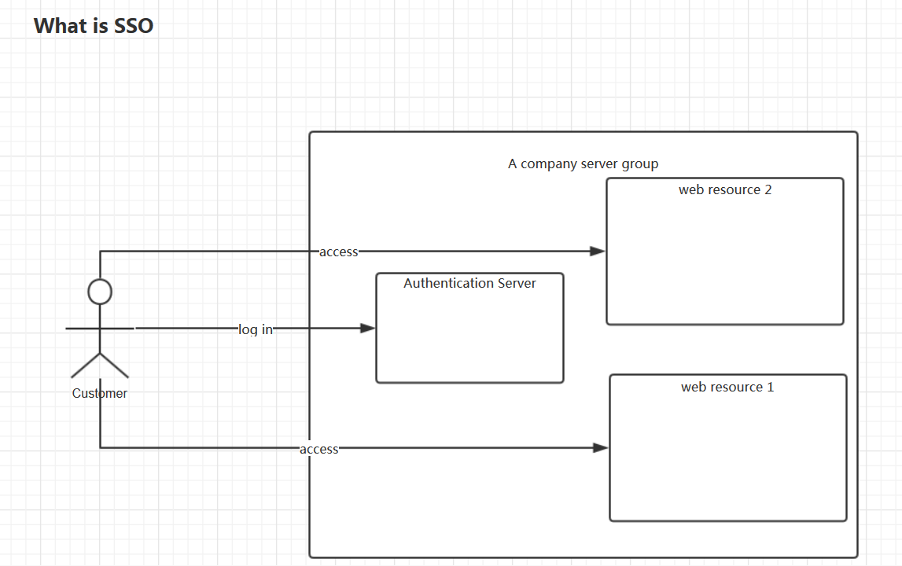

Slide 5
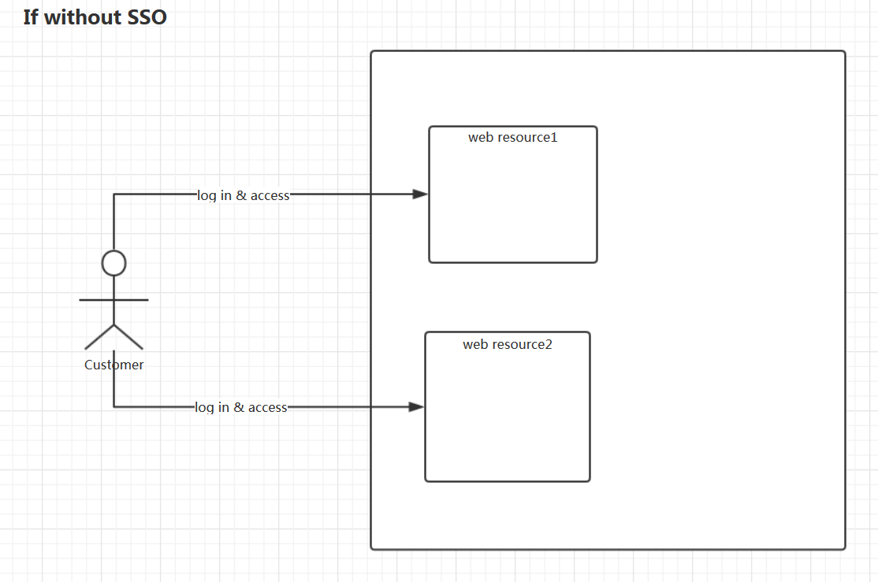

Slide 6
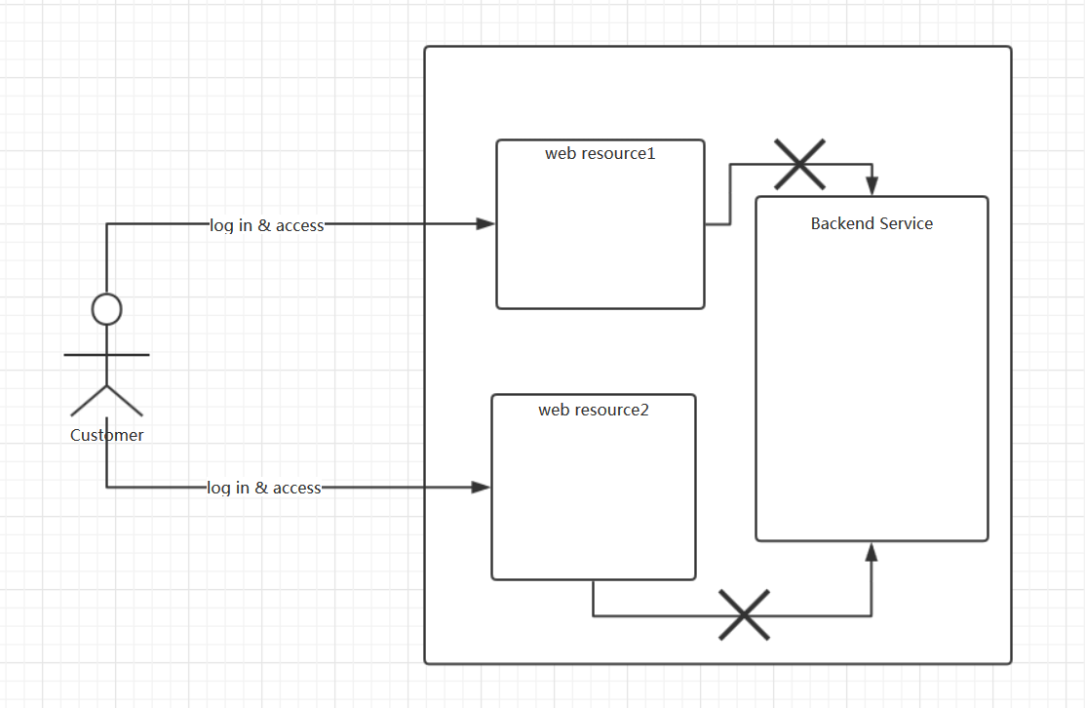

Slide 7
SSO In One Enterprise
Why we need SSO and how to implement it
The definition of SSO: Single sign-on (SSO) is a property of access control of multiple related, but independent software systems. With this property a user logs in with a single ID to gain access to a connected system or systems without being prompted for different usernames or passwords, or in some configurations seamlessly sign on at each system.
https://en.wikipedia.org/wiki/Single_sign-on

Slide 8
SSO In One Enterprise
Why we need SSO and how to implement it
Advantages And Disadvantages Of SSO:
Advantages
Reduces user password fatigue from different username and password combinations
Reduces time spent re-entering passwords
Reduces IT costs due to lower number of IT help desk calls about passwords
Provides detailed reporting on user access
All authentication is delegated to the identity provider. Therefore, the web resource environment never proxies the user credentials.
Disadvantages
If the identity provider is unavailable, access to all associated service providers is lost. SSO can thus be undesirable for systems requiring guaranteed access at all times, such as security or plant-floor systems.
If a user's credentials are compromised, an unauthorized user may gain access to all of the resources that are protected by the compromised identity provider. Ensure that credentials are stored securely, and consider implementing strong authentication methods such as smart-cards and one-time password tokens.

Slide 9
SSO In One Enterprise
Why we need SSO and how to implement it
How to do SSO in WSC: In ecommerce we use LDAP to do it
What is LDAP.
The Lightweight Directory Access Protocol is an open, vendor-neutral, industry standard application protocol for accessing and maintaining distributed directory information services over an Internet Protocol(IP) network. Directory services play an important role in developing intranet and Internet applications by allowing the sharing of information about users, systems, networks, services, and applications throughout the network.

Slide 10
As examples, directory services may provide any organized set of records, often with a hierarchical structure, such as a corporate email directory. Similarly, a telephone directory is a list of subscribers with an address and a phone number.
For example, here is an LDAP search translated into plain English: "Search in the company email directory for all people located in Nashville whose name contains 'Jesse' that have an email address. Please return their full name, email, title, and description."
A common usage of LDAP is to provide a single sign on where one password for a user is shared between many services, such as applying a company login code to web pages (so that staff log in only once to company computers, and then are automatically logged into the company intranet).

Slide 11
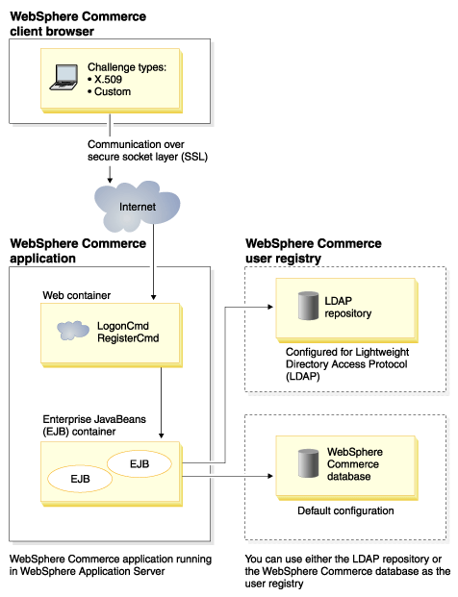

Slide 12
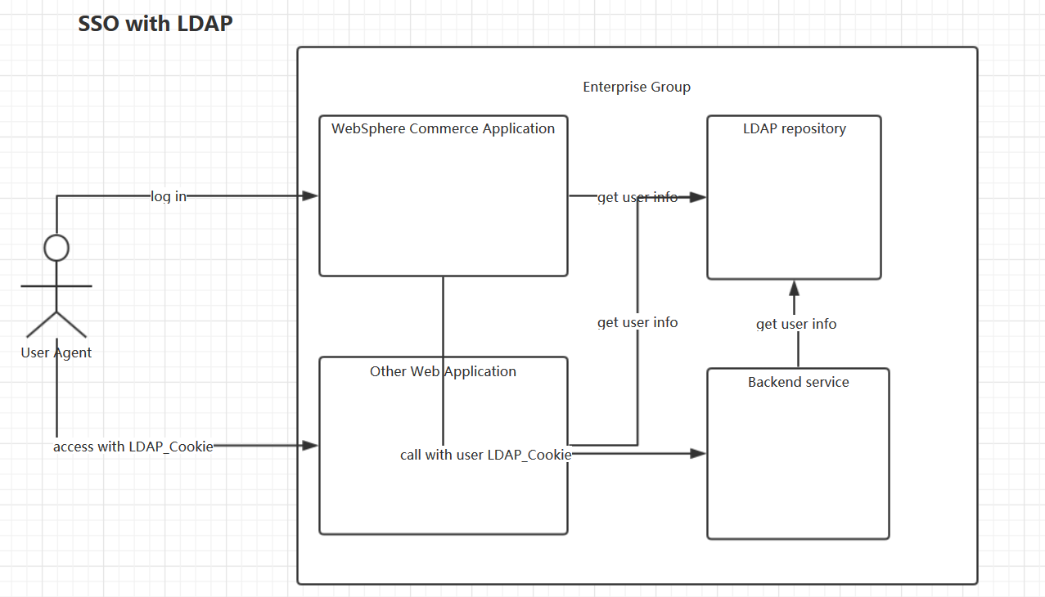

Slide 13
SSO In One Enterprise
Why we need SSO and how to implement it
SSO with CAS
What is CAS:
The Central Authentication Service (CAS) is a single sign-on protocol for the web. Its purpose is to permit a user to access multiple applications while providing their credentials (such as userid and password) only once. It also allows web applications to authenticate users without gaining access to a user's security credentials, such as a password.
Reference: https://en.wikipedia.org/wiki/Central_Authentication_Service

Slide 14
SSO In One Enterprise
Why we need SSO and how to implement it
Features of CAS:
Java (Spring Webflow/MVC servlet) server component
Pluggable authentication support (LDAP, database, X.509, 2-factor)
Support for multiple protocols (CAS, SAML, OAuth, OpenID)
Cross-platform client support (Java, .Net, PHP, Perl, Apache, etc)
Integrates with uPortal, Liferay, BlueSocket, Moodle, and Google Apps to name a few
Reference: http://jasig.github.io/cas/4.1.x/index.html

Slide 15
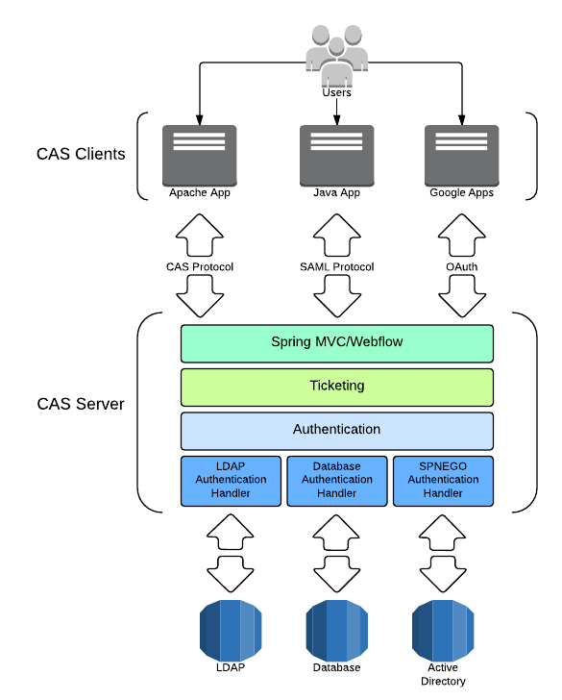

Slide 16
SSO In One Enterprise
Why we need SSO and how to implement it
CAS Protocol

